Slide 1
Code Review Techniques
Are:
Meeting led by and for technical people
Technical assessment of work product created during SE process
Software QA mechanism
Are NOT:
Project summary or assessment
Meeting intended to share information
Mechanism for some type of political or personal gain (leave your ego home!)

Slide 2
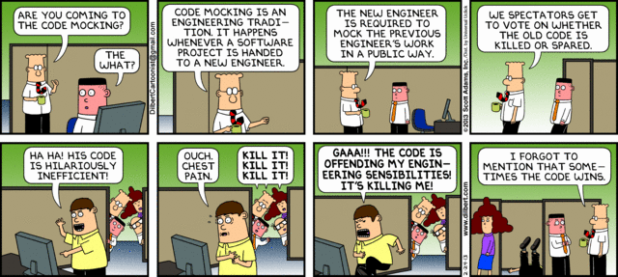
Code Reviews – What NOT to do!

Slide 3
Goals of Reviews
Find errors & defects
Error
Quality problem found before software is released
Defect
Quality problem found after software has been released
Purpose of making distinction:
Each has different impacts
(i.e. economic, business, human, etc.)

Slide 4
Informal Reviews
Informal reviews include:
Simple check of a work product with a colleague
Casual meeting with purpose of reviewing work product
Review-oriented aspects of pair programming
Pair programming
Encourages continuous review during design and implementation of work product
Benefit (in theory)
Immediate discovery of errors
Better work product quality

Slide 5
Formal Technical Reviews (FTR)
Objectives:
Uncover errors (function, logic, or implementation) in software
Verify software under review meets requirements
Ensure software has been written according to predefined standards
Developed in uniform manner (different coding styles)
Make projects more manageable

Slide 6
Review Meeting
Small group should be involved
Includes advance preparation
Not excessive (less than few hours per person)
Duration of review meeting should be limited to few hours or less
Focus
Work product
i.e. Part of requirements model, source code for given component

Slide 7
Review Participants
Producer
Developer of work product
Informs project lead that work product is done and ready for review
Review leader
Does initial evaluation of product for readiness, makes copies of product materials, and distributes them to reviewers for advance preparation.
Reviewer(s)
Spends few hours reviewing product, making notes, and becoming familiar with work
Recorder
Reviewer who documents important issues found during the review

Slide 8
Guidelines - The Code Review
Don’t get personal →
Review the product and not the author
Stick to the agenda
Not debate session
Find problems BUT avoid trying find solution for each
Clearly document issues
Limit participants
Make sure they prep first
Keep checklist for products to be reviewed
Properly allocate your time and resources
Educate your reviewers
Make sure to re-evaluate your review process periodically

